Slide 1
Introduction to Movement Breaks
This presentation will help staff:
Understand the benefits of movement breaks
Know what to do before getting started with movement breaks
Know when movement breaks can be used
Learn how to use movement breaks to help identify learners who may be having difficulties

Slide 2
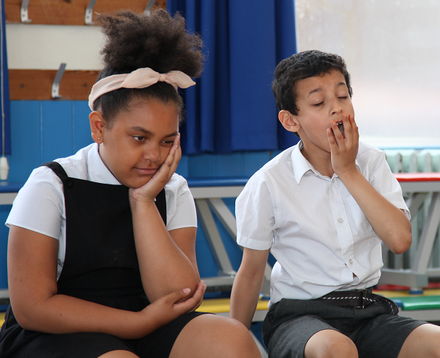
Benefits of Movement Breaks for All Children
All children need to move regularly in order to learn:
This is because to balance, to sit upright and to concentrate, they need to frequently activate sensory systems.
Just moving at break times and P.E. isn’t enough
When children have been still and quiet for a long amount of time, their attention starts to fade.
To reactivate their focus, regular movement breaks throughout the day, both in and out of lessons, are essential.

Slide 3
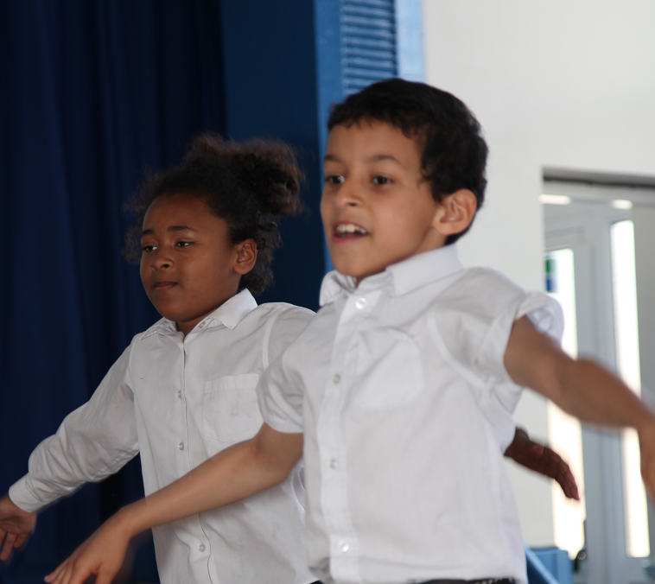
Benefits of Movement Breaks for All Children
The movement break sequences in this resource can be used in classrooms with children and have been designed to help them concentrate and support their physical skills.
They also demonstrate that children can move in the classroom in a safe and structured manner and that they enjoy it.

Slide 4
Benefits of Movement Breaks for All Children
Other benefits include working together and social skills as some of the breaks are designed to be carried out in pairs.
The activities also foster creativity and independence as they give guidance on how pupils can design their own movement breaks to support themselves and their classmates.

Slide 5
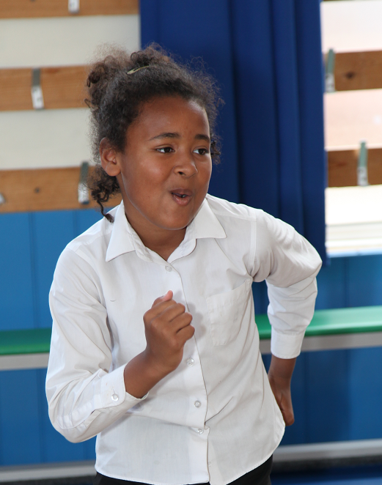
Before you start with the movement break sequences
The majority of sequences are based on weight bearing, resistance and stretch activities.
These can be used at transition times and after coming in from morning and lunchtime breaks to provide the appropriate physical and sensory input for learning.
They have been especially designed to ensure that they should not over stimulate children, particularly those with physical and sensory difficulties

Slide 6
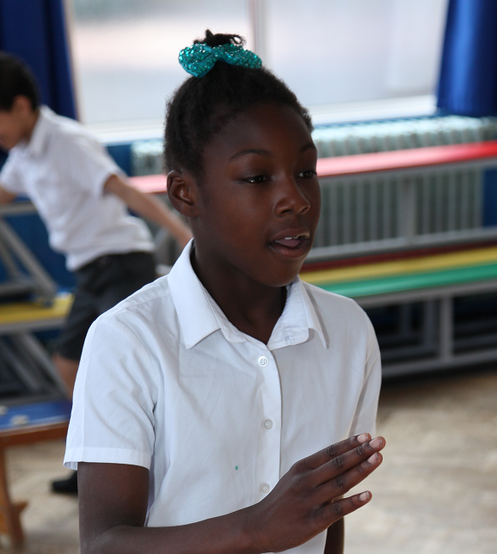
Alerting Movement Breaks
The alerting movement breaks can be done when the class is particularly sluggish to wake them up ready to concentrate again.

Slide 7
Important Checks Before Using The Movement Break Sequences in This Resource
Safety is paramount so ensure that the learners do these activities in a safe and appropriate manner and that the space is suitable
i.e. no potential hazards
Please be sensitive if there are young people with physical difficulties in the class
Consider the appropriateness of doing these activities without suitable sequences for them.
Please check with a relevant professional e.g. occupational therapist or physiotherapist about the suitability of these exercises if there are children with physical difficulties in the class
They my have suggestions for them and the rest of the class.

Slide 8
When can these movement breaks be done? Suggestions for incorporating these into the school day
General Movement Breaks (Combination of resistance, weight bearing and stretching activities)
Beginning of day, after playtimes and lunch to get them ready to sit down and start concentrating.
When transitioning between activities – switch time.
Alerting Movement Breaks (Combination of aerobic and stretching activities)
When transitioning between activities when particularly sluggish– Switch time.
Handwriting Warm Up and Cool Down Movement Breaks (Combination of hand and arm activities)
In preparation for periods of handwriting – see section 2 for more details

Slide 9
Identifying Difficulties in Movement Breaks:
It is important to remember that these exercises support all children to learn and develop, and not just those with physical difficulties.
However, movement breaks are also a good opportunity to identify:
Pupils who find some of the physical activities challenging
Whether movement breaks support some pupils’ ability to sit and attend
Whether particular children become over-stimulated by movement
Should you notice any particular issues certain learners might be experiencing when carrying out the sequences , the activities in Sections 4 and 5 may help.

